Slide 1
Cybersecurity & Cryptography -Module III
Prepared by Prof. Bismi K. Charleys

Slide 2
Message Authentication
Message Authentication
message authentication is concerned with:
  protecting the integrity of a message
  validating identity of originator
  non-repudiation of origin (dispute resolution)
For the security requirements ,three alternative functions used
hash function
  message encryption
  message authentication code (MAC)

Slide 3
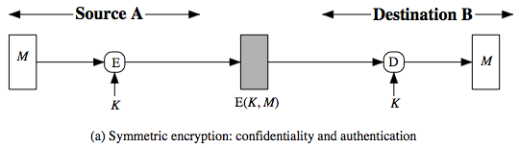
  Message authentication using encryption.
Symmetric Message Encryption
encryption can also provides authentication.
if symmetric encryption is used then:
  receiver know sender must have created the message since only sender and receiver know the key which is used.
  know content cannot have been altered...... if message has suitable structure, redundancy or a suitable checksum to detect any changes.

Slide 4
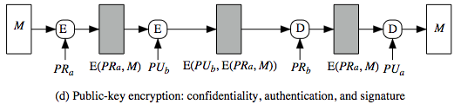
Message authentication using encryption
if public-key encryption is used:
  encryption provides no confidence of sender since anyone potentially knows public-key
  However if
    sender signs message using their private-key then encrypts the message with recipients public key then both secrecy and authentication achived.

Slide 5
Hash Functions and MAC
Hash functions. A cryptographic hash function is a mathematical algorithm that maps data of arbitrary size to a bit array of a fixed size. It is a one-way function, that is, a function which is practically infeasible to invert. A hash function H accepts a variable-length block of data M as input and produces
a fixed-size hash value h = H(M).
Properties of hash functions-
cryptographic hash functions exhibit these three properties:

Slide 6
Properties of hash functions
They are “collision-free.” This means that no two input hashes should map to the same output hash.
They can be hidden. It should be difficult to guess the input value for a hash function from its output.
They should be puzzle-friendly. It should be difficult to select an input that provides a pre-defined output. Thus, the input should be selected from a distribution that's as wide as possible.

Slide 7
Message Authentication Code(MAC)
MAC is generated by an algorithm that creates a small fixed-sized block.
  depending on both message and secret key
  like encryption though need not be reversible
appended to message as a “signature”
receiver performs same computation on message and checks it matches the MAC
provides assurance that message is unaltered and comes from sender

Slide 8
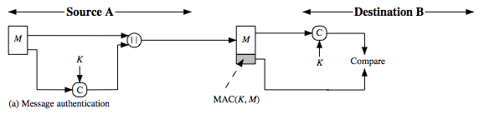
Message Authentication Code
MAC is a small fixed-sized block of data
  generated from message + secret key
  MAC = C(K,M)
  appended to message when sent.

Slide 9
Message Authentication Codes
As shown in the figure the MAC provides authentication
can also use encryption for secrecy.
  generally use separate keys for each
  can compute MAC either before or after encryption
  why use a MAC?
  sometimes only authentication is needed
  sometimes need authentication to persist longer than the encryption (e.g. archival use)
note that a MAC is not a digital signature
    Does NOT provide non-repudiation

Slide 10
MAC Properties
A MAC is a cryptographic checksum
  MAC = C_{K}(M)
  condenses a variable-length message M
  using a secret key K
  to a fixed-sized authenticator
is a many-to-one function
  potentially many messages have same MAC
  but finding these needs to be very difficult.
  knowing a message and MAC, is infeasible to find another message with same MAC

Slide 11
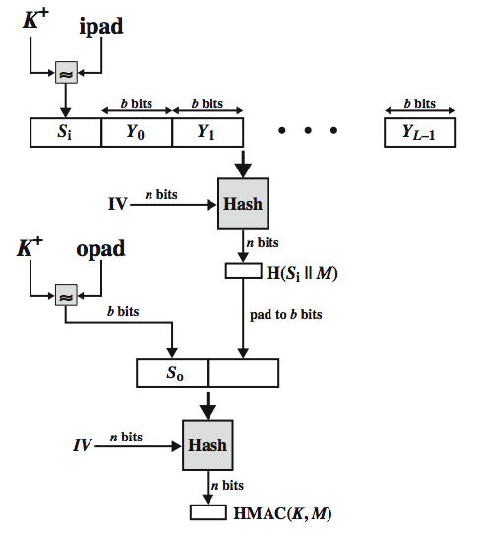
HMAC

Slide 12
HMAC Algorithm
K 🡪 shared key b/w sender and receiver and 0< K <= b.
Next we have generate K⁺ from the above K.
K⁺ 🡪 pad zeros to the left of ‘K’ until the length become ‘b’ bits.
Eg: binary representation of decimal 2 in four bit form is 0010.
In the algorithm size of ‘ plaintext block’ is ‘b’ bits.
In this algorithm we are using two paddings.They are ipad & opad.
ipad 🡪 00110110 --- b/8 times.
opad🡪 01011100 --- b/8 times.
After this calculate ‘S’ bits.
K⁺ (b bits) ⊕ ipad(b bits) 🡪S₁( b bits)

Slide 13
HMAC Algorithm
HMAC steps
Select K, where 0<K<= b . if K<b then pad zeros to the left until K=b.
XOR K⁺ with ipad , then we will get ‘b’ bits= S₁
Append S1 with plain message M.
Apply SHA- 512 on (S1|| M) = n bits.
Pad ‘n’ bits until length = ‘b’ bits.
XOR K⁺ with opad will get ‘b’ bits which is S₀.
Append S₀ with step 5
Apply SHA-512 on step 7, so that n bits will be ouput( hash code)

Slide 14
CBC-MAC
In cryptography, a cipher block chaining message authentication code (CBC-MAC) is a technique for constructing a message authentication code from a block cipher. The message is encrypted with some block cipher algorithm in CBC mode to create a chain of blocks such that each block depends on the proper encryption of the previous block. This interdependence ensures that a change to any of the plaintext bits will cause the final encrypted block to change in a way that cannot be predicted or counteracted without knowing the key to the block cipher. To calculate the CBC-MAC of message m, one encrypts m in CBC mode with zero initialization vector and keeps the last block. The following figure sketches the computation of the CBC-MAC of a message comprising blocks m1 || m2||….|| m_{x} using a secret key k and a block cipher E

Slide 15
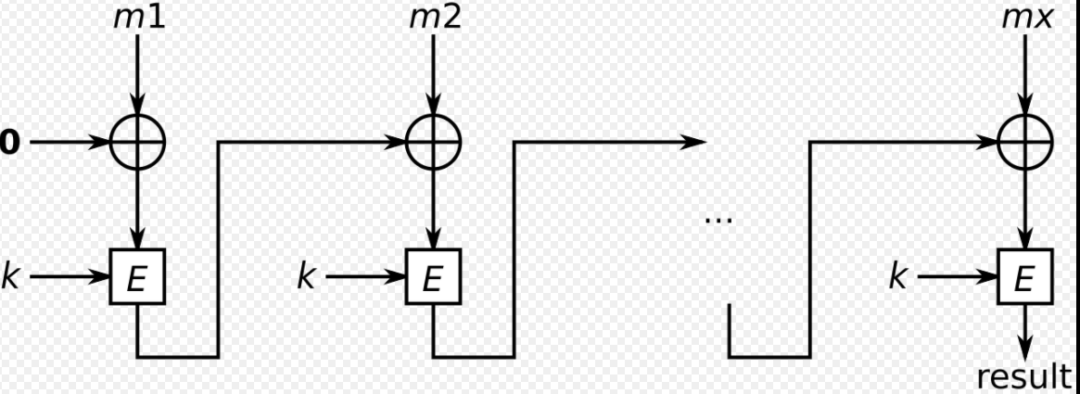
CBC-MAC

Slide 16
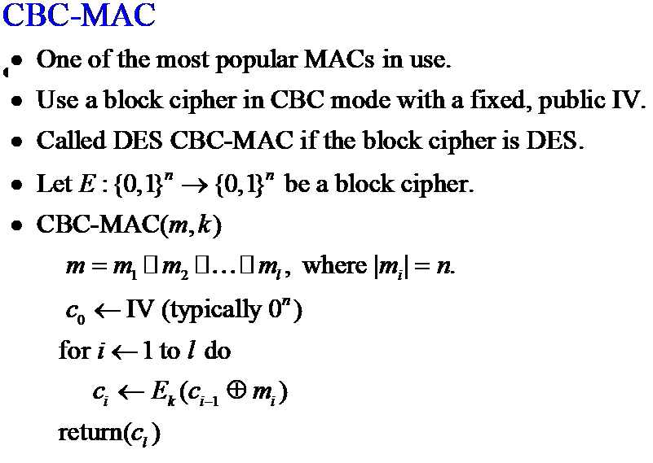
CBC-MAC

Slide 17
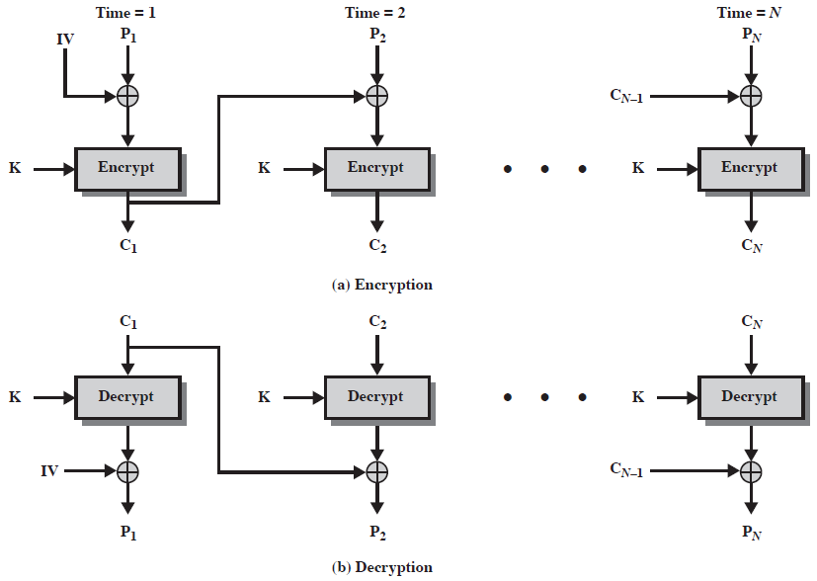
Cipher Block Chaining (CBC)

Slide 18
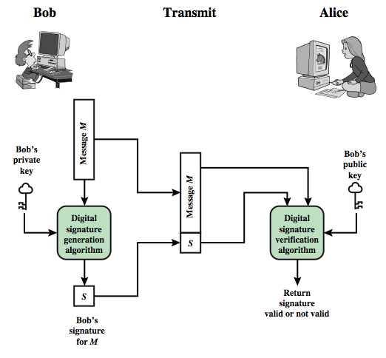
Digital Signature
  Digital signatures are used to authenticate message contents . Digital signature also need to achieve data integrity and non-repudiation
  If the message is encrypted using senders private key, then it is called digital signature.

Slide 19
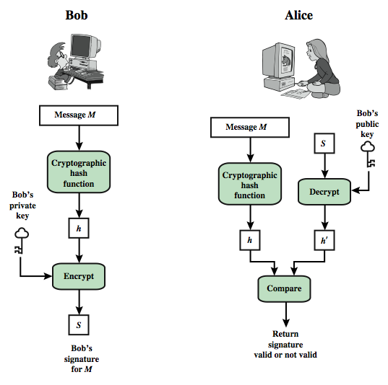
Digital Signature

Slide 20
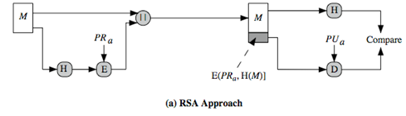
Digtal signature methods
RSA
DSS( Digital Signature Standard)
RSA

Slide 21
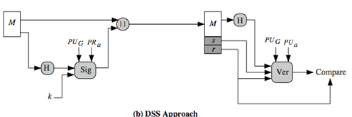
Digital Signature Methods
DSS or DSA

Slide 22
DSS
Algorithm steps:
Global public key components
    p- prime number , 2^{L-1} < p < 2^{L} where L= 512 to 1024 bits and is a multiple of 64 bits.L is the length of bits.
q - is the prime divisor of p-1
g- h^{(p-1)/q} mod p. Here ‘h’ is any integer which lies between 1 < h < p-1.
User private key
x- random number, where 0 < x <q.
User public key
y = g^{x} mod p

Slide 23
DSS
Select ‘k’ which is any integer where 0 <k <q.
Signature components
r= (g^{k} mod p) mod q.
s =[k⁻¹(H(M) + x.r)]mod q
Verifying function
V=[(g^{u1}.y^{u2} ) mod p ] mod q
u1=[H(M’)w] modq.
w= (s’)⁻¹ mod q
u2= [(r’) w mod q]
Here M’,r’,s’ are in the receiver side.
V==r’

Slide 24
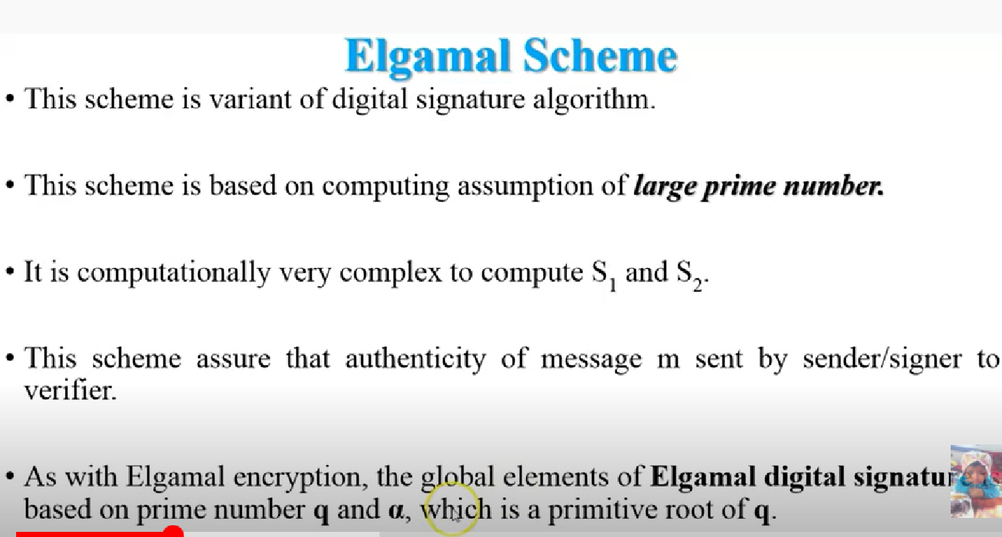
Elgamal Digtal Signature

Slide 25
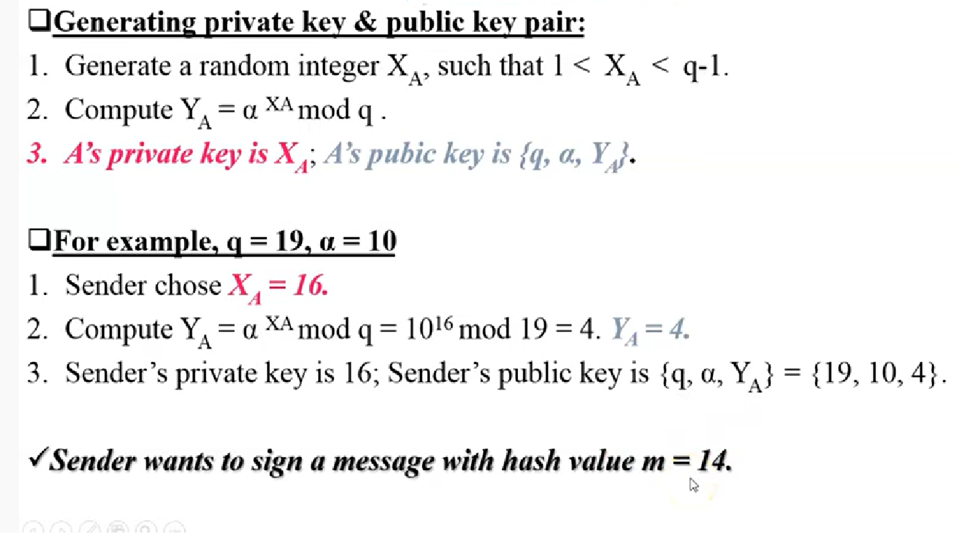

Slide 26
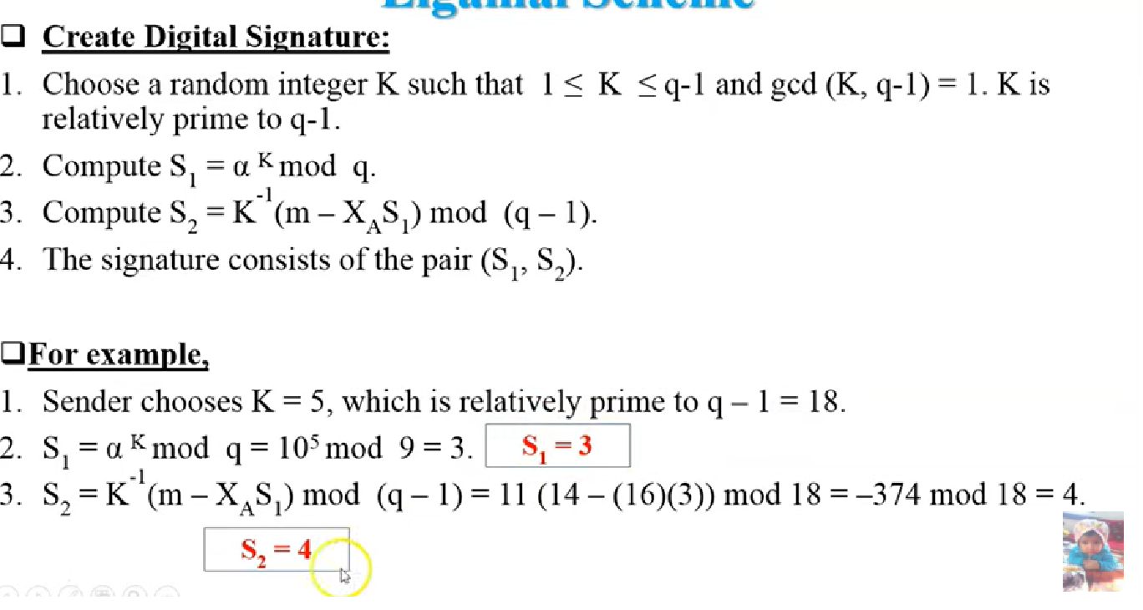

Slide 27
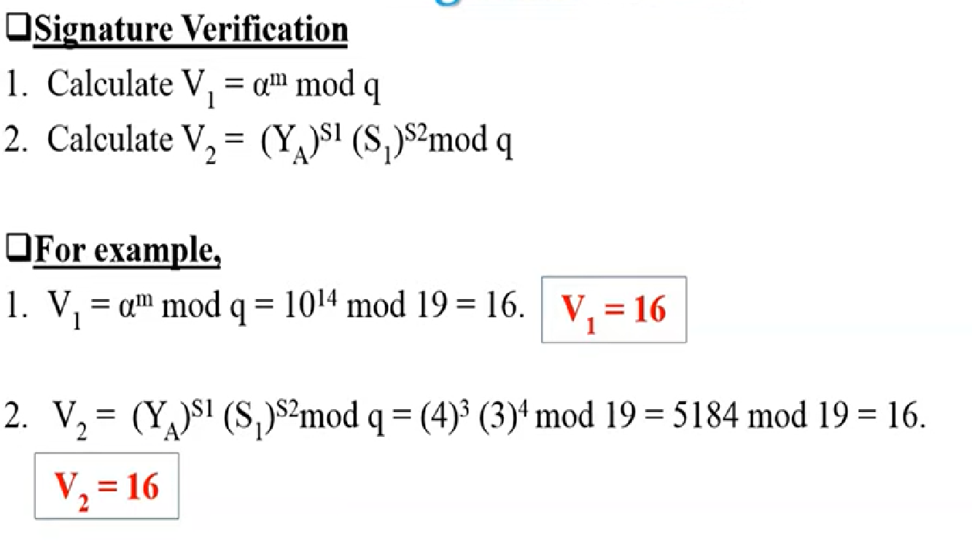

Slide 28
Schnorr Scheme
Schnorr signature scheme is based on discrete logarithms.
It is a digital signature scheme known for its simplicity.
It is efficient and generates short signatures.
also uses exponentiation in a finite (Galois)
  security based on discrete logarithms, as in D-H
minimizes message dependent computation
  multiplying a 2n-bit integer with an n-bit integer
main work can be done in idle time
have using a prime modulus p
  p–1 has a prime factor q of appropriate size
  typically p 1024-bit and q 160-bit numbers

Slide 29
Schnorr Key Setup
choose suitable primes p , q
choose a such that a^{q} = 1 mod p
(a,p,q) are global parameters for all
each user (e.g., A) generates a key
  chooses a secret key (number): 0 < s_{A} < q
  compute their public key: v_{A} = a^{-sA} mod q

Slide 30
Schnorr Signature Creation
user signs message by
  choosing random r with 0<r<q and computing x = a^{r} mod p
  concatenate message with x and hash result to computing: e = H(M || x)
  computing: y = (r + se) mod q
  signature pair is (e, y)
any other user can verify the signature as follows:
  computing: x' = a^{y}v^{e} mod p
  verifying that: e = H(M || x’)

Slide 31
Attacks On Digital Signature
Key only attacks.
Known-message attack.
Chosen-message attack.
Key only Attack: In key-only attack, the public key of A is available to every one and C makes use of this fact and try to recreate the signature of A and digitally sign the documents or messages that A does not intend to do. This would cause a great threat to authentication of the message which is non repudiated as A cannot deny signing it.

Slide 32
Attacks On Digital Signature
Chosen Message Attack: The chosen attack method is of two types:
1)Generic chosen-method – In this method C tricks A to digitally sign the messages that A does not intend to do and without the knowledge about A’s public key.
2)Direct chosen-method – In this method C has the knowledge about A’s public key and obtains A’s signature on the messages and replaces the original message with the message C wants A to sign with having A’s signature on them unchanged.
Known Message Attack: In this type of attack, the attacker obtains some messages, that the user sends and a key to create a new fault message and forge of the user. Known Message attack is also known as Known Plain Text attack

Slide 33
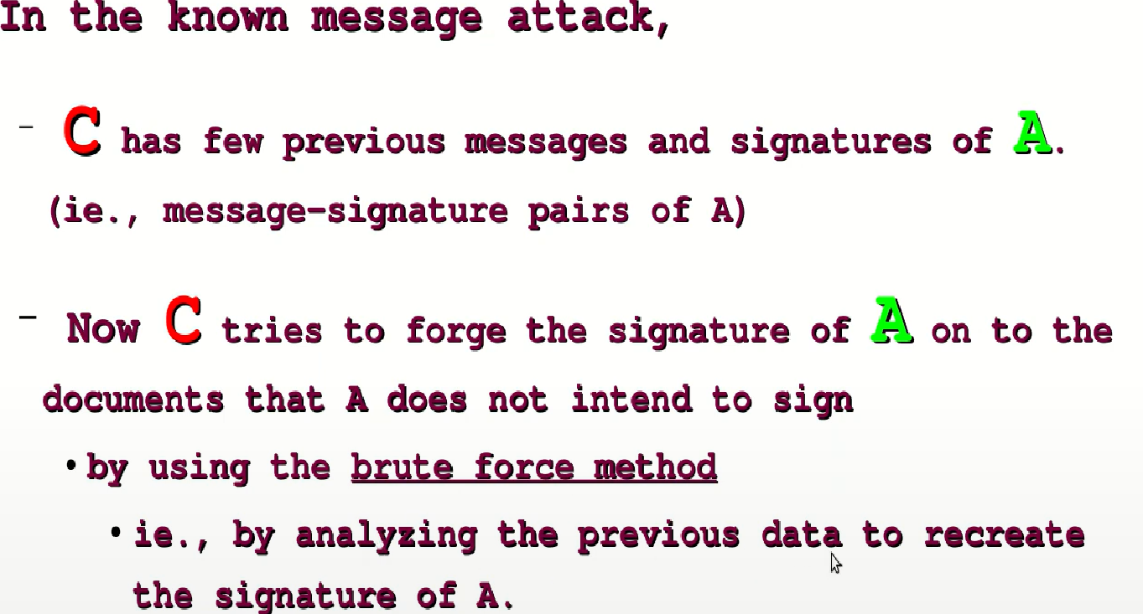

Slide 34
BLIND SIGNATURE
In cryptography a blind signature, as introduced by David Chaum, is a form of digital signature in which the content of a message is disguised (blinded) before it is signed. The resulting blind signature can be publicly verified against the original, unblinded message in the manner of a regular digital signature. Blind signatures are typically employed in privacy-related protocols where the signer and message author are different parties. Examples include cryptographic election systems and digital cash schemes.

